Slide 1
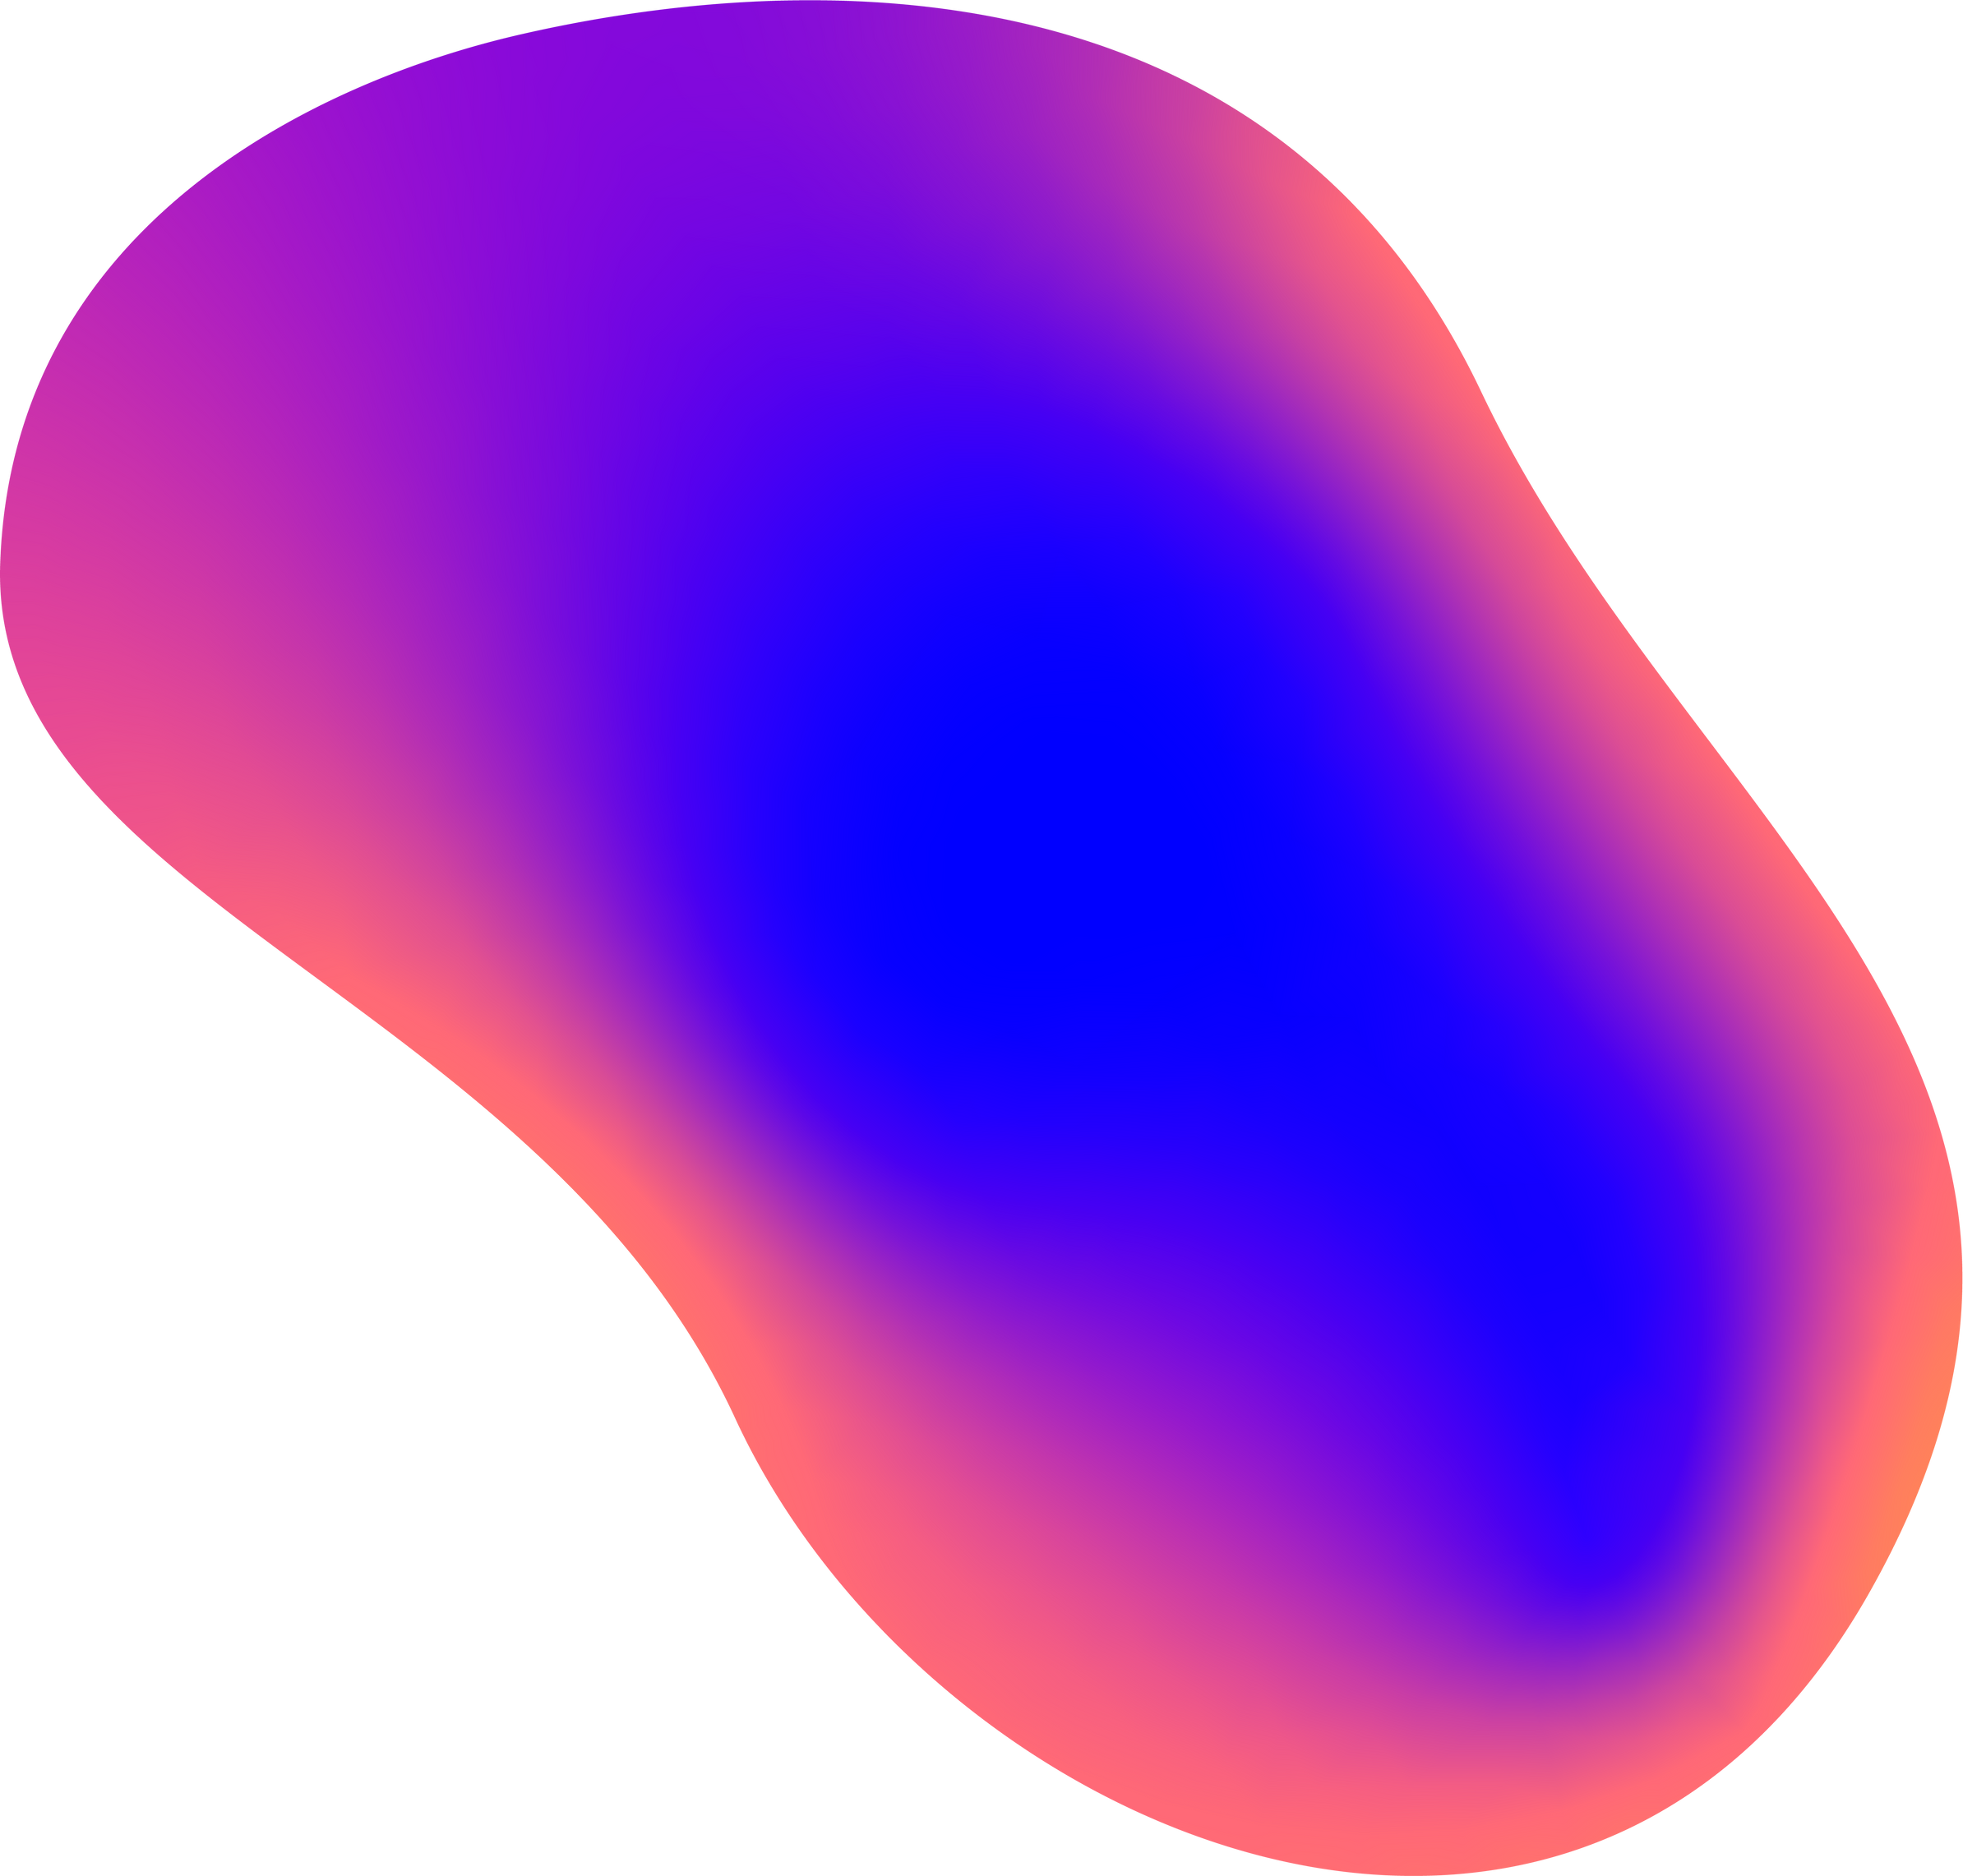
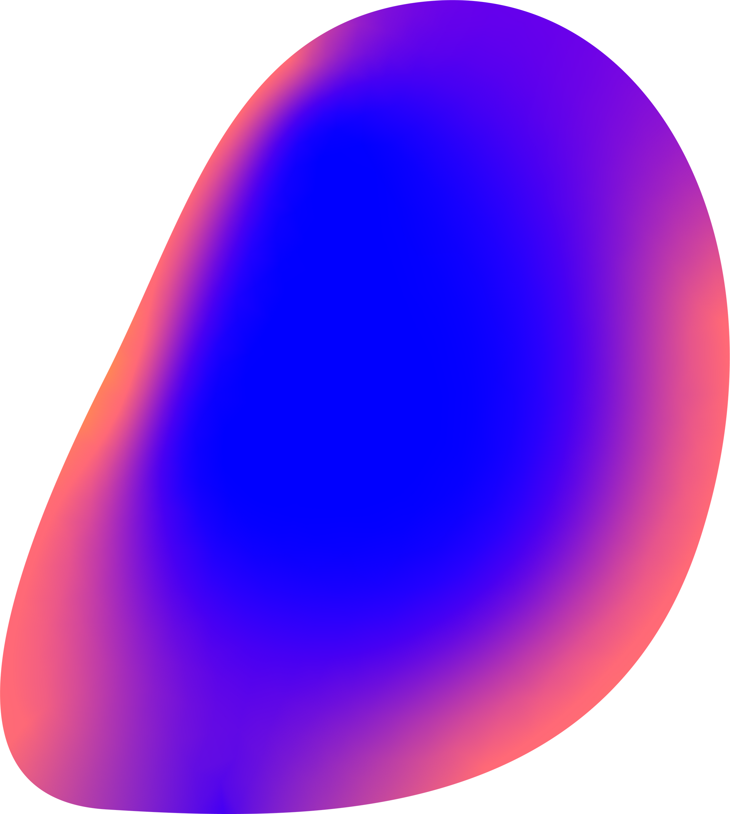
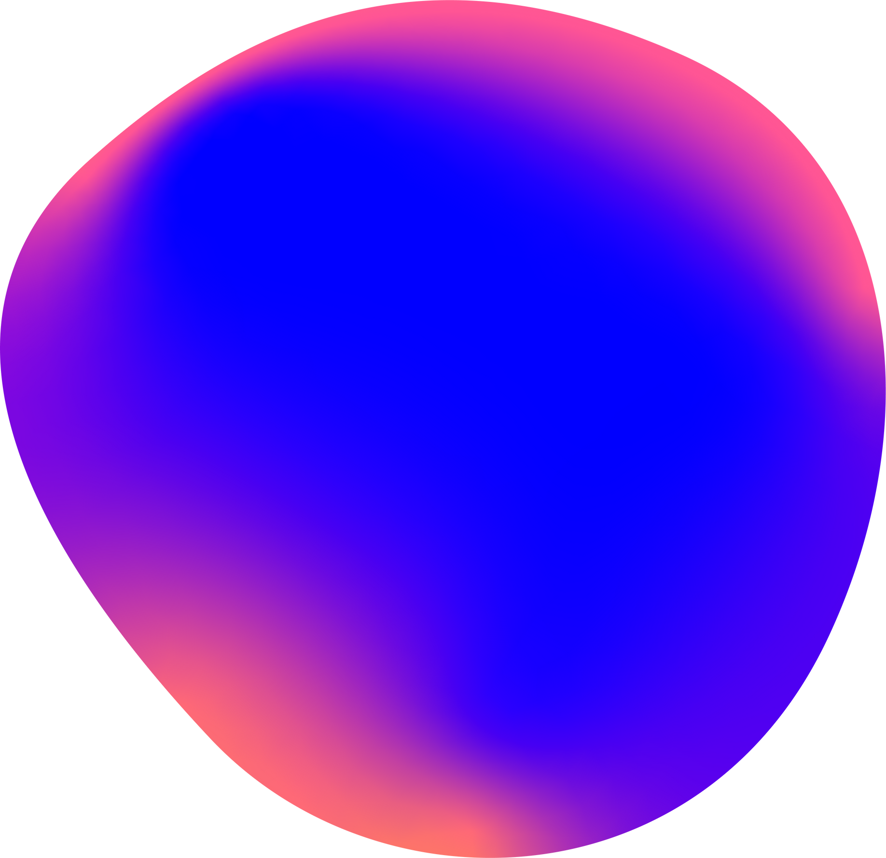
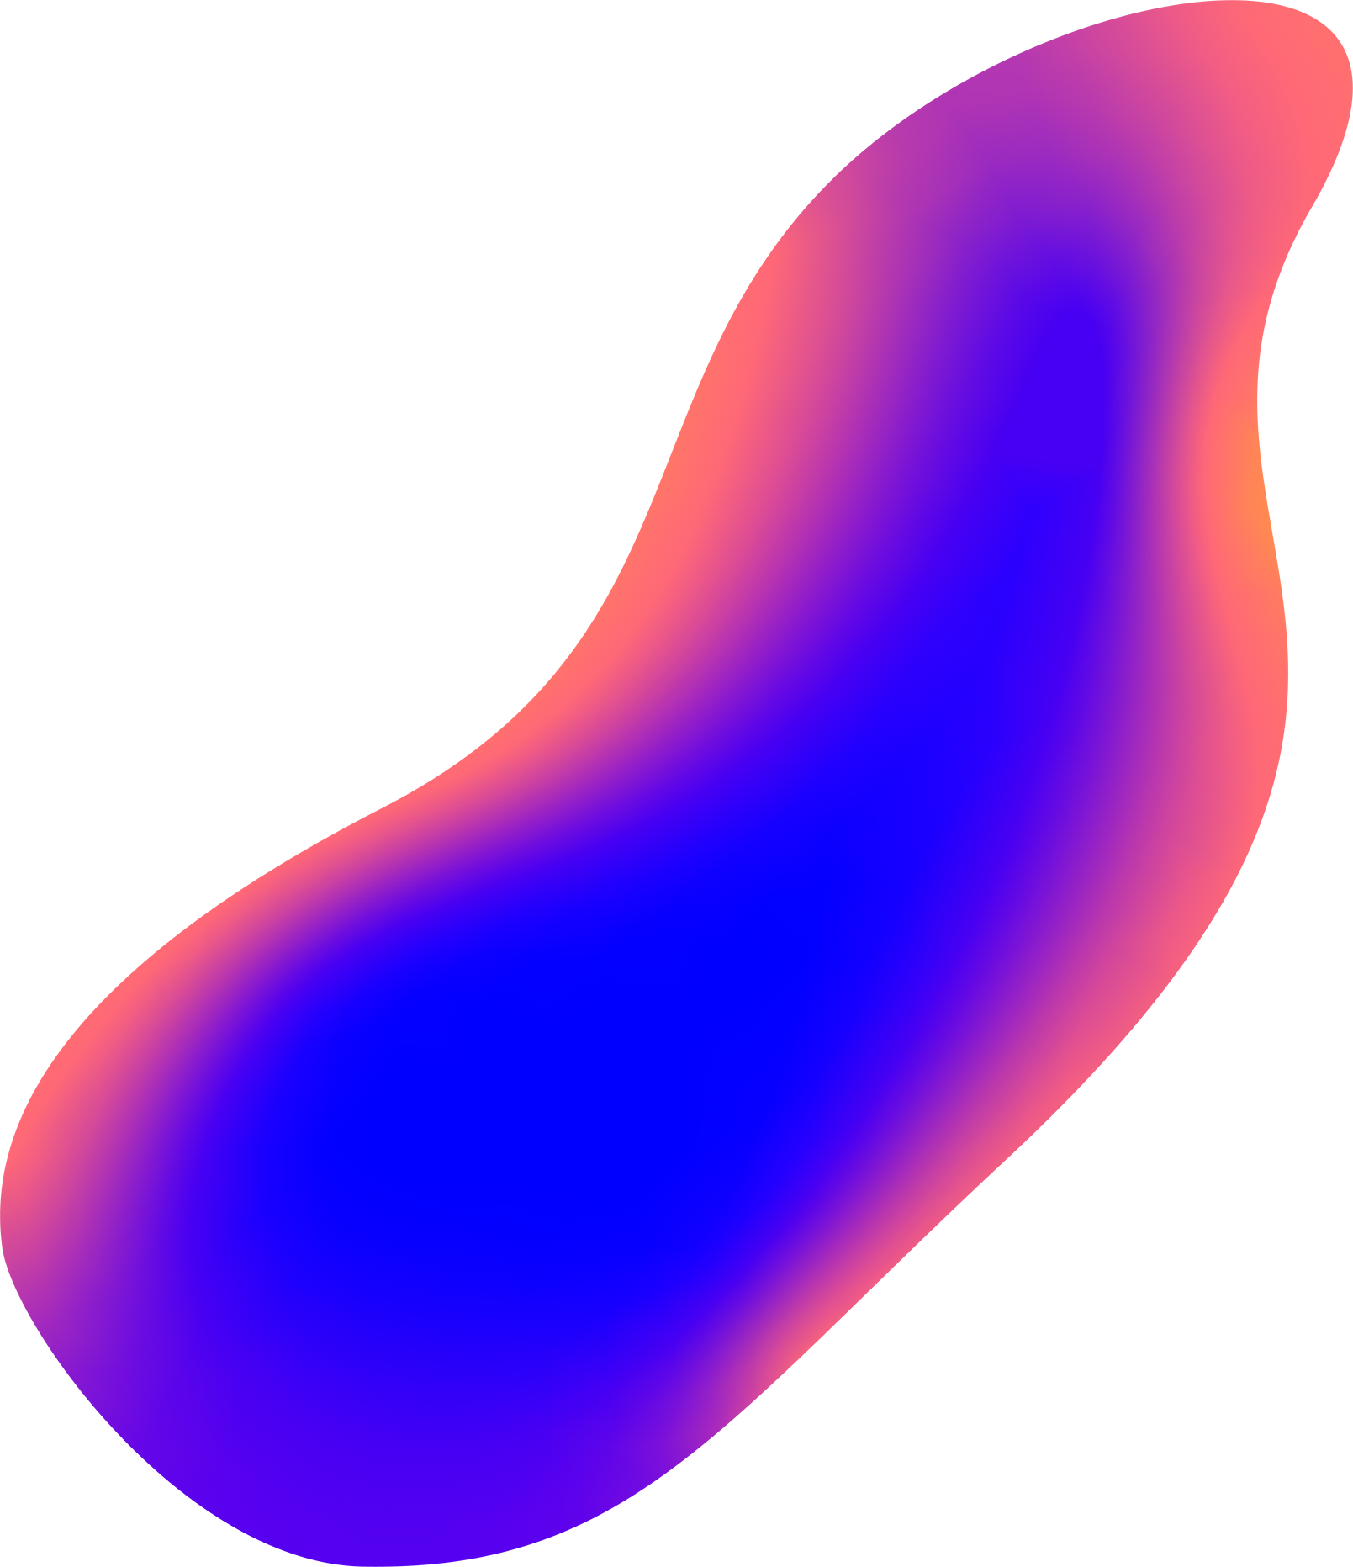
Fetal Health Classification Using Ensemble Learning
By :
J.KANISHKHA
2019A7PS0072U

Slide 2
WHAT IS FETAL HEALTH CLASSIFICATION?
WHAT IS CTG DATA?
WHAT IS ENSEMBLE LEARNING ?

Slide 3
Reasearch Paper Discussion
Akbulut, A., Ertugrul, E., & Topcu, V. (2018). Fetal health status prediction based on maternal clinical history using machine learning techniques. Computer methods and programs in biomedicine, 163, 87-100.
Miao, J. H., & Miao, K. H. (2018). Cardiotocographic diagnosis of fetal health based on multiclass morphologic pattern predictions using deep learning classification. International Journal of Advanced Computer Science and Applications, 9(5).
Kuhle, S., Maguire, B., Zhang, H., Hamilton, D., Allen, A. C., Joseph, K. S., & Allen, V. M. (2018). Comparison of logistic regression with machine learning methods for the prediction of fetal growth abnormalities: a retrospective cohort study. BMC pregnancy and childbirth, 18(1), 1-9.
Muhammad Hussain, N., Rehman, A. U., Othman, M. T. B., Zafar, J., Zafar, H., & Hamam, H. (2022). Accessing artificial intelligence for fetus health status using hybrid deep learning algorithm (AlexNet-SVM) on cardiotocographic data. Sensors, 22(14), 5103.
Chen, Y., Guo, A., Chen, Q., Quan, B., Liu, G., Li, L., ... & Hao, Z. (2021). Intelligent classification of antepartum cardiotocography model based on deep forest. Biomedical Signal Processing and Control, 67, 102555.
Rahmayanti, N., Pradani, H., Pahlawan, M., & Vinarti, R. (2022). Comparison of machine learning algorithms to classify fetal health using cardiotocogram data. Procedia Computer Science, 197, 162-171.

Slide 4
Reasearch Paper Discussion
Nadia et al [4] have created a classification algorithm by using AlexNet along with a support vector machine to analyze cardiotocography data to classify the data into 3 classes (Normal, Pathological, and Suspected). This along with using transfer learning has allowed for a better real-time performance result with an accuracy of 99.72%.
Kuhle et al [3] have compared logistic regression with machine learning methods to predict fetal growth abnormalities. They classified infants into 3 categories and tried to predict SGA and LGA based on the information before pregnancy and 26-week gestation. They tried to compare the different comparison methods of multiple logistic regression and machine learning methods like classification trees, neural networks, etc.

Slide 5

Practical Applications
Monitoring fetal well-being during labor.
Identifying risk factors for fetal distress.
Determining the need for cesarean delivery.
Evaluating the effectiveness of interventions.
Research and development.

Slide 6
Practical Applications
Real world Usage
Hospitals and other healthcare facilities
Medical device manufacturers
Research organizations.
Software development companies.

Slide 7


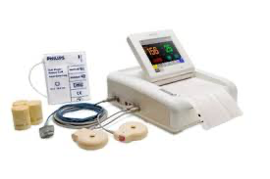

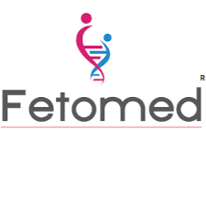
Practical Applications
Companies that use
Philips Avalon FM20

Slide 8



Implementation
Programming
Language
Programming Software
Dataset Repository
Python
Google Colab
Kaggle
Machine Learning Repository

Slide 9
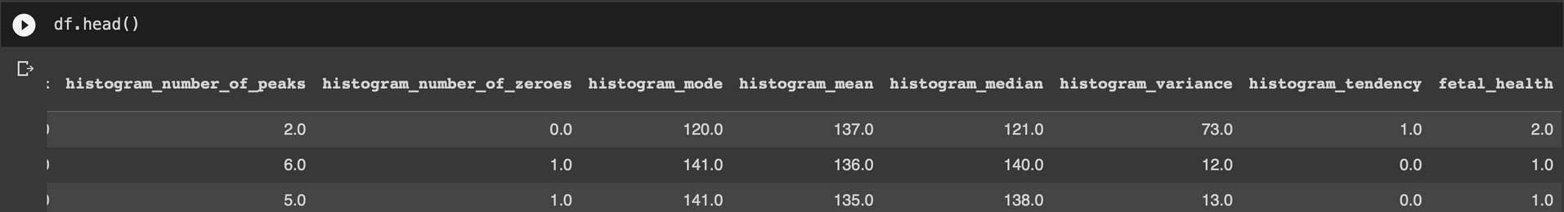
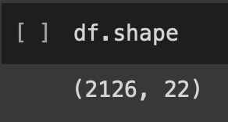
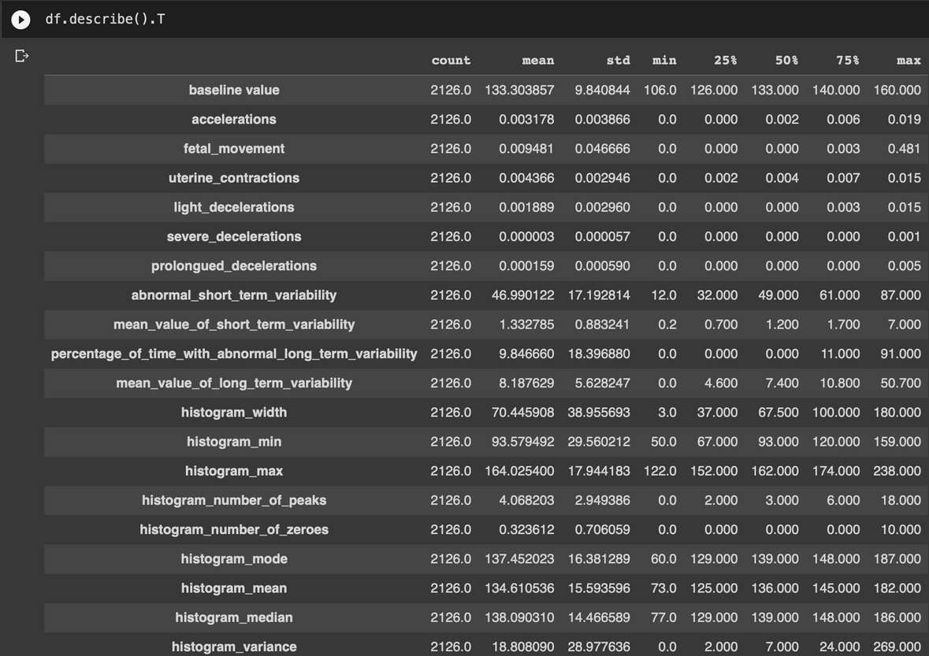
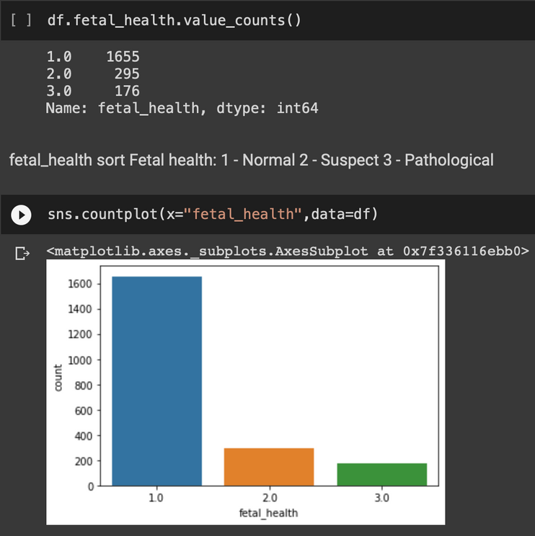
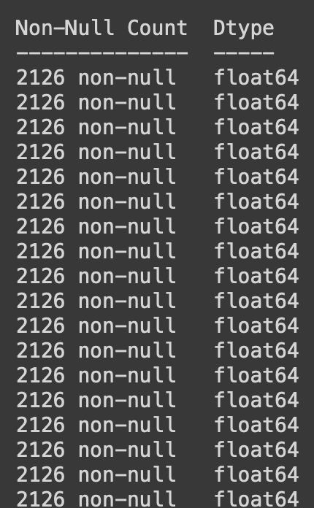
Datasets

Slide 10
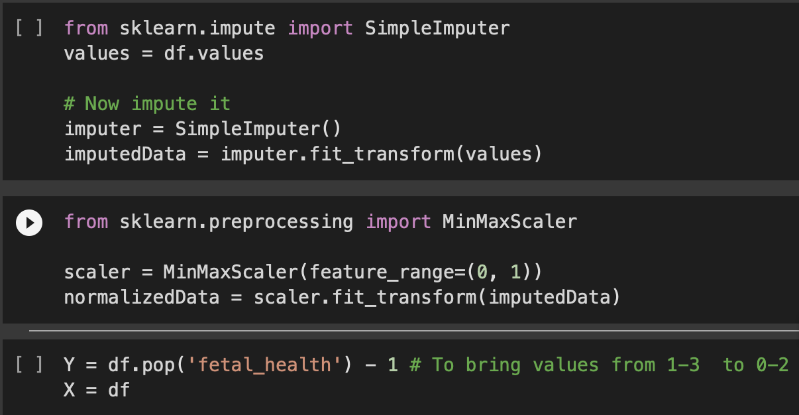
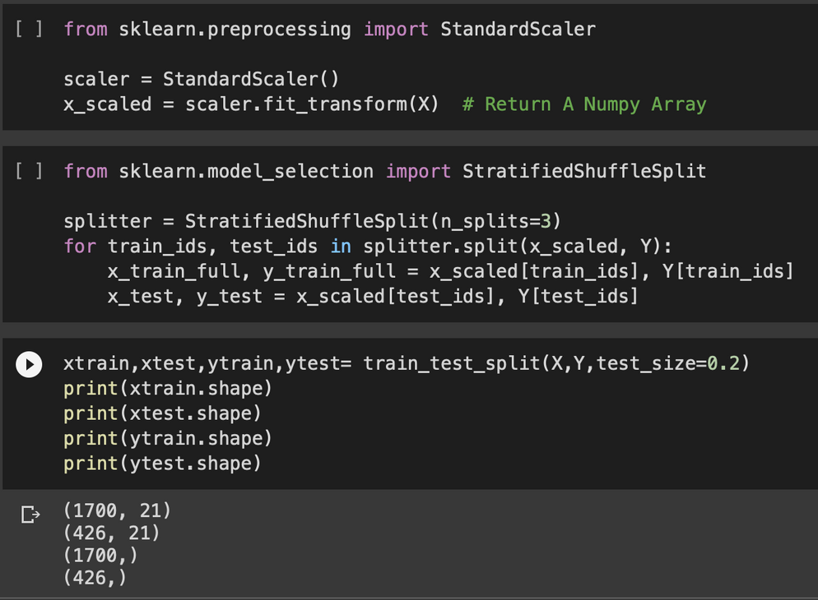
Train test split

Slide 11
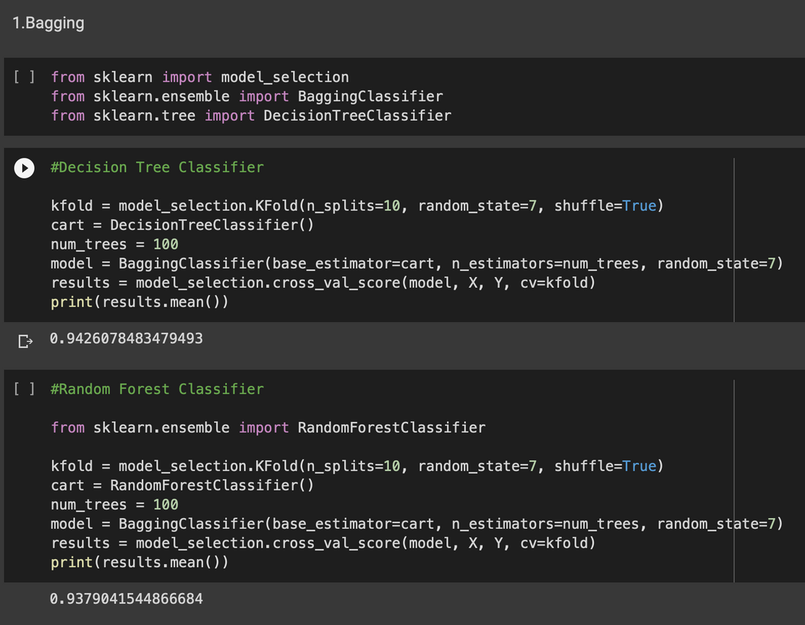
Ensemble Learning
1.Bagging

Slide 12
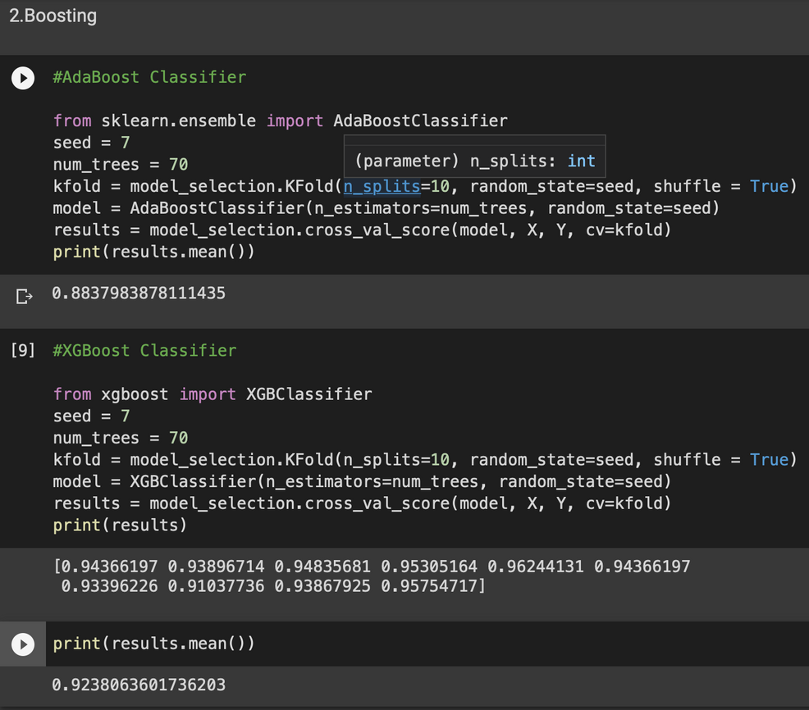
Ensemble Learning
2.Boosting

Slide 13
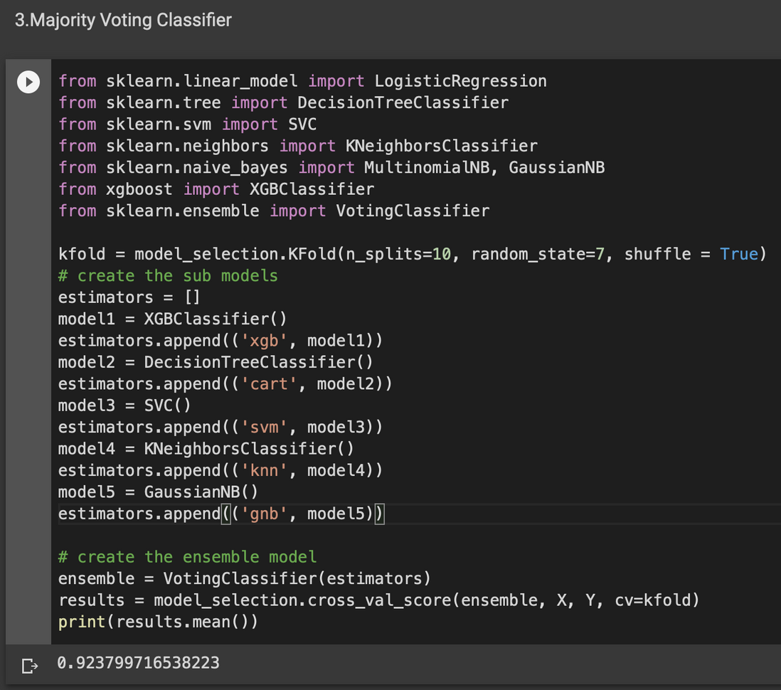
Ensemble Learning
3.Majority Voting Classifier

Slide 14
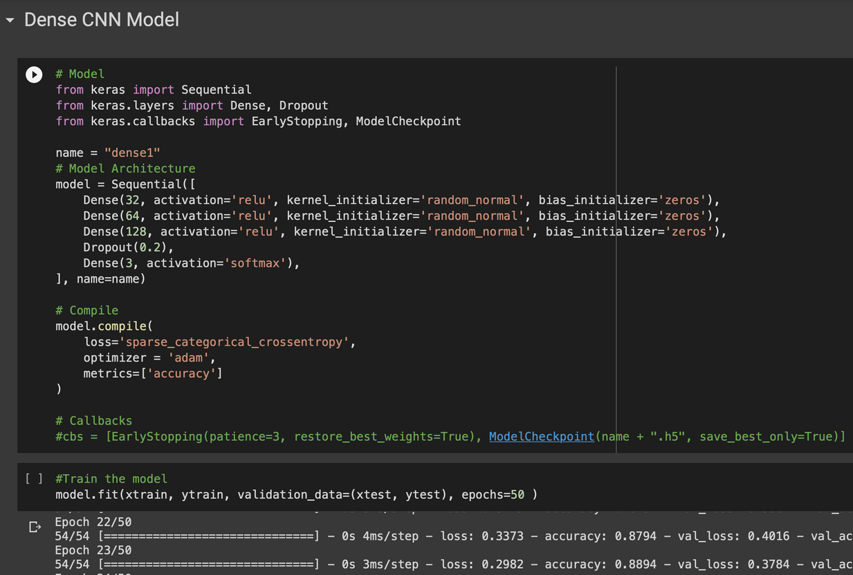
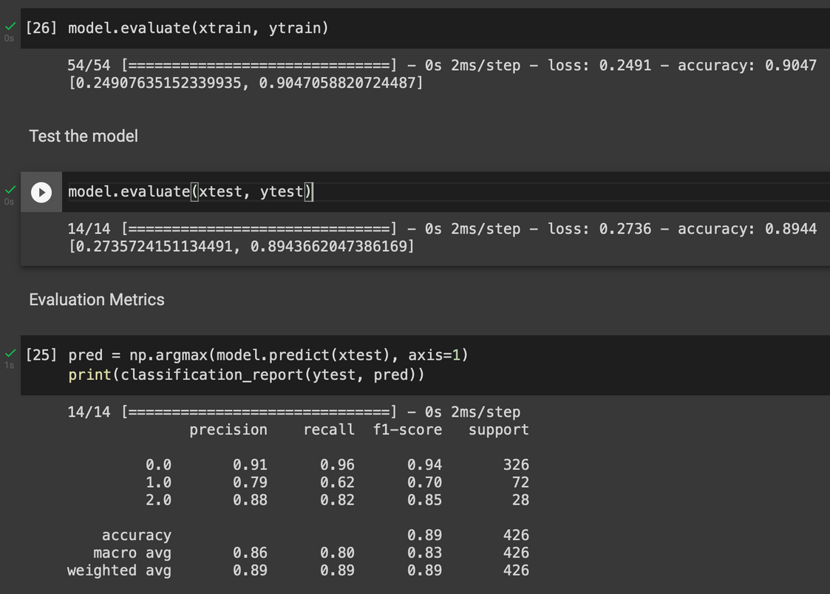
Dense CNN Model

Slide 15
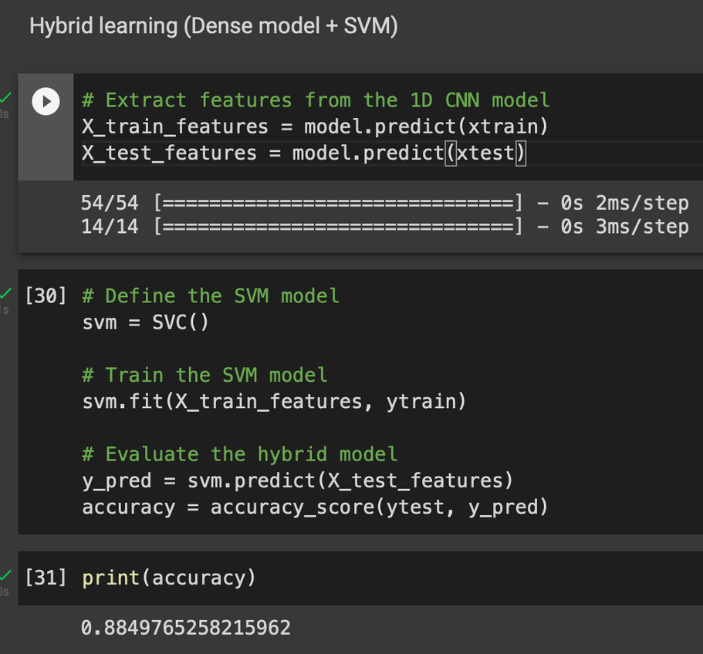
Hybrid learning Model
Dense CNN + SVM

Slide 16
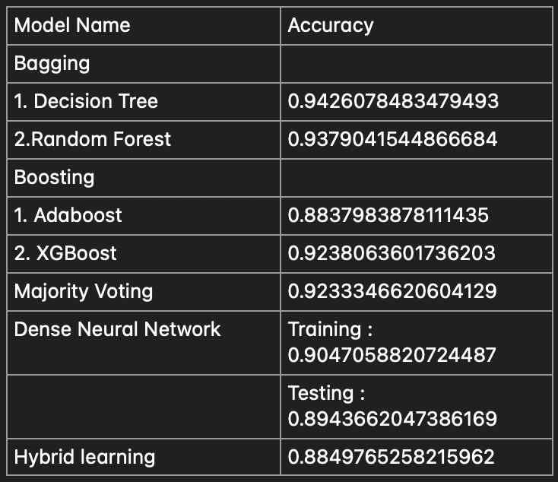
RESULTS

Slide 17
DISCUSSION & CONCLUSION
Bagging Model with Decision Tree classifier gave the best accuracy of 0.942.
A simple webApp can be developed and Bagging model can be deployed & Everyone can have access to it.
Future research can be worked on baby ultrasound images.

Slide 18
THANK YOU !!!
BY :
J.KANISHKHA
2019A7PS0072U

Slide 19
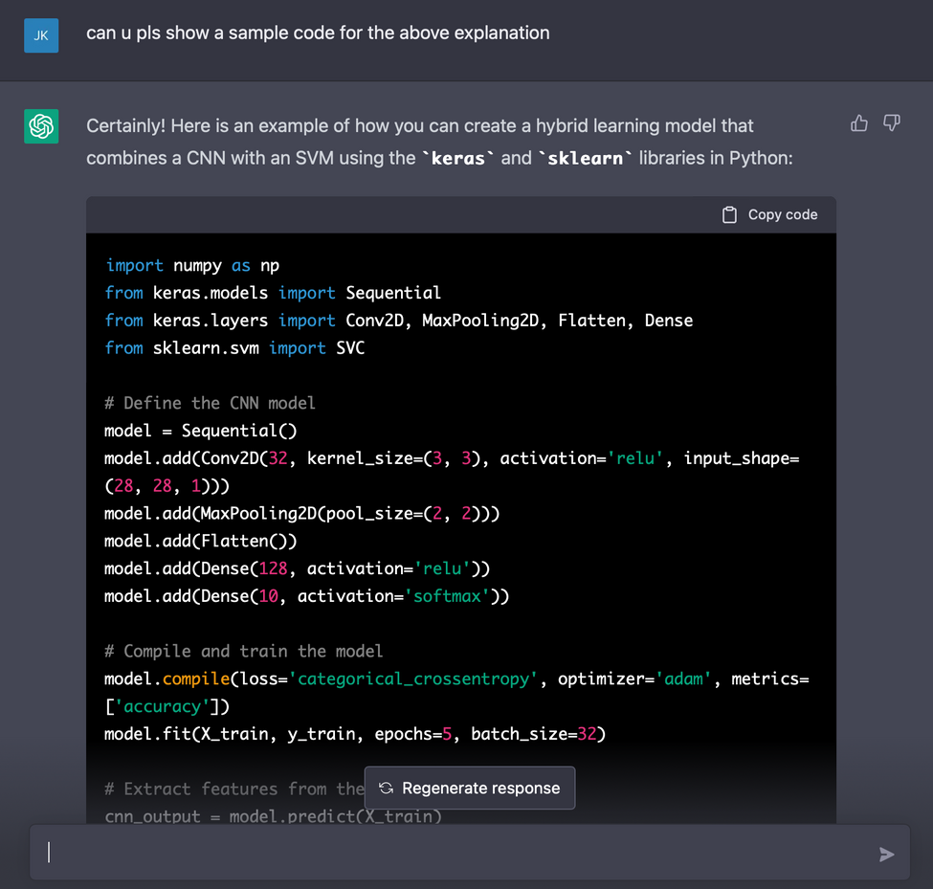
SPECIAL MENTION

